Slide 1
SAP Ariba Guidelines Bidding Process

Slide 2
CONTENT
I. Bidding Overview Process
II. Step by step

Slide 3
I. Bidding Overview Process
Supplier receive invitation email from NSRP to join bidding event (RFI/RFP/Sourcing) in NSRP’s Ariba Network
Supplier provide detail information and document for the bidding package then submit to NSRP
Procurement Department will review information
Result will be informed by NSRP after finalization

Slide 4
CONTENT
I. Bidding Overview Process
II. Step by step

Slide 5
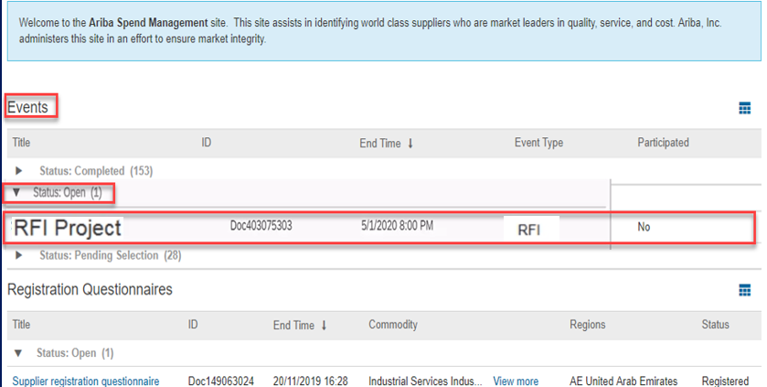
II. Step by step (RFI)
Access to your supplier account in SAP Ariba. In section Ariba Proposal:
Sourcing Events can be seen under Events Section
Click Status: Open to expand the event and this will provide what are events which are still open that you need to submit your response with. And click the Event name.
Events section had the following sub-sections:
Completed - RFP’s/ RFI/Auctions which have been awarded to you/ some other supplier
Open - RFP’s / RFI/Auctions for which you have to submit bid.
Pending Selection: RFP’s / RFI/Auctions which are no longer accepting bids.
Preview : RFP / RFI/Auctions which have been published by the buyer, but are yet to start
1
2

Slide 6
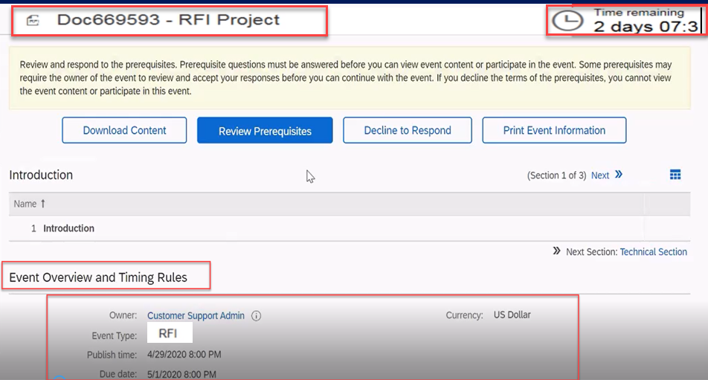
II. Step by step (RFI)
Review Event Details
After clicking the event you would like to participate, Event details will display.
Time Remaining – Time remaining before the event close.
Event Overview and Timing Rules – This shows Owner, Event Type, Publish Time, Due Date, and Currency
2
1
3

Slide 7
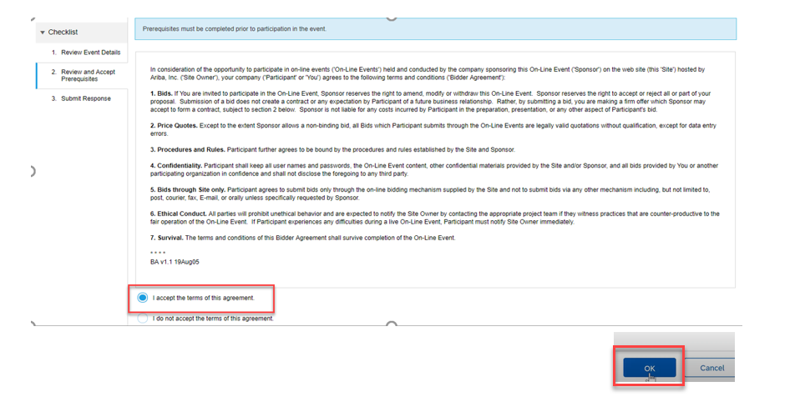
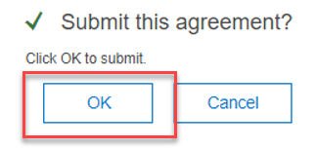
II. Step by step (RFI)
Review Prerequisite
Click Review Prerequisites button
Review the terms of this agreement and click the radio button beside I accept the terms of this agreement. By accepting the agreement you can now participate in the sourcing event.
Click OK button.
Submit this agreement window displays. Click OK to Submit.
1
4
2
3

Slide 8
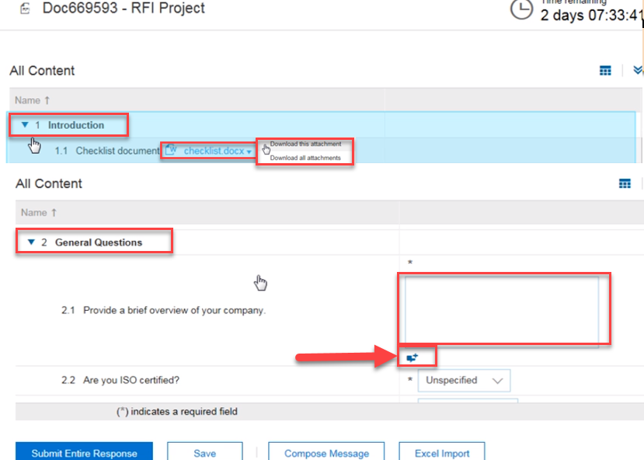
II. Step by step (RFI)
Submit Response
Review the Introduction Section. To access the document click the document and download the attachments.
General Questions Section. All fields marked with an * are mandatory. There could be a drop down menu. And based on the answers provided additional questions may appear.
You can optionally add comments or attachment if there is an attach icon on the question. Click Attach icon.
1
2
3

Slide 9
II. Step by step (RFI)
Attach a document or a comment
Add/Edit Comment window displays. Add comment on the comment field.
Click Attach a file for you to be able to attach a document.
Add attachment window displays. Click Browse.
4
5
6

Slide 10
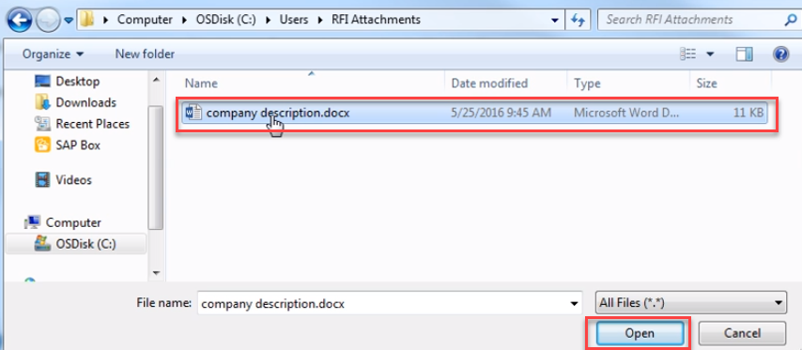
II. Step by step (RFI)
Attach a document or a comment
Attach the document and click Open.
Document are now attached. Click OK.
Click OK to return to the event. If you wish to update or delete the file you may do so.
c
a
b

Slide 11
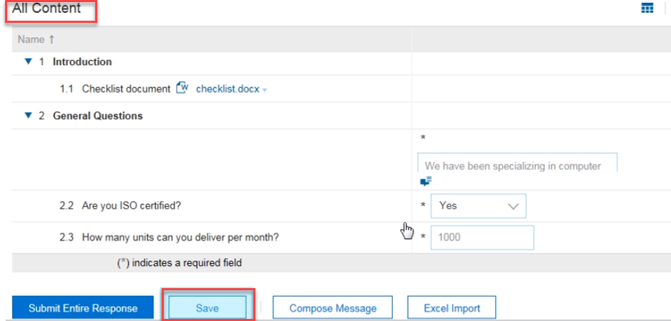
II. Step by step (RFI)
Submit Response
All Content window displays. If you are responding to a long RFI, we recommend to Save it first. To Save the responses, click Save Button.
Green ribbon displays at the top of the screen which states, Your Entries have been saved but not yet been submitted to the event owner. Continue working on your response and submit when you are finished.
7
8

Slide 12
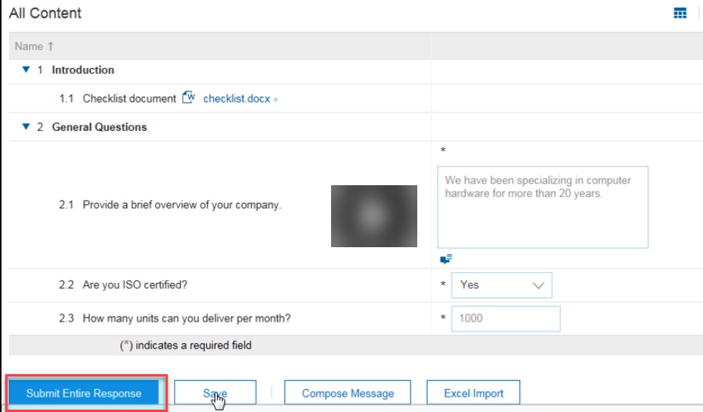
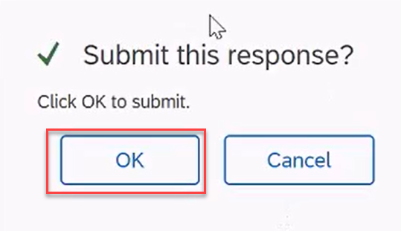
II. Step by step (RFI)
Submit Response
When all response has been completed. Click Submit Entire Response.
Submit response window displays. Click OK.
10
9

Slide 13
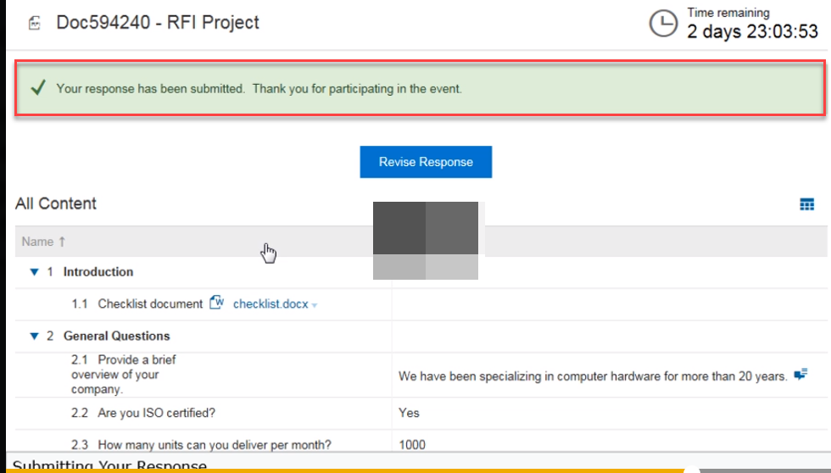
II. Step by step (RFI)
Submit Response
A confirmation in green ribbon will display on the screen. Which states, Your response has been submitted. Thank you for participating in the event.

Slide 14
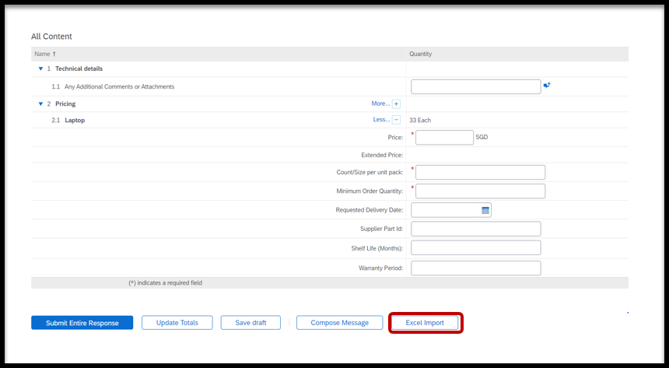
II. Step by step (RFI)
Click on Excel Import

Slide 15
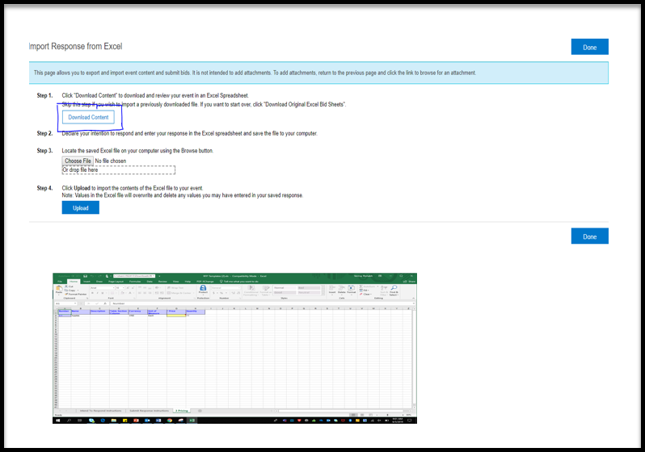
II. Step by step (RFI)
Follow the steps :
Click on Download Content
An excel sheet would be downloaded.
Open the excel sheet > go
to pricing tab. Enter your responses
Save your file

Slide 16
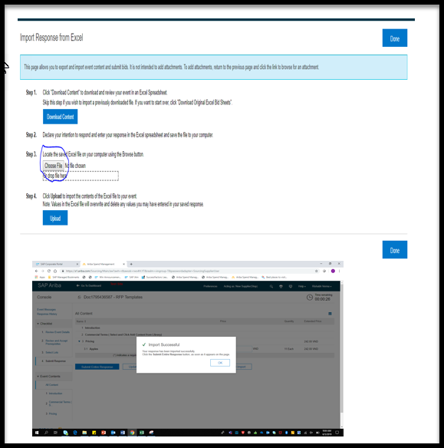
II. Step by step (RFI)
Go to Step 3 > Choose file to upload > upload
Once the excel file is imported successfully, a dialogue box will appear > Import Successful. Click ok.
Click Submit Entire response.

Slide 17
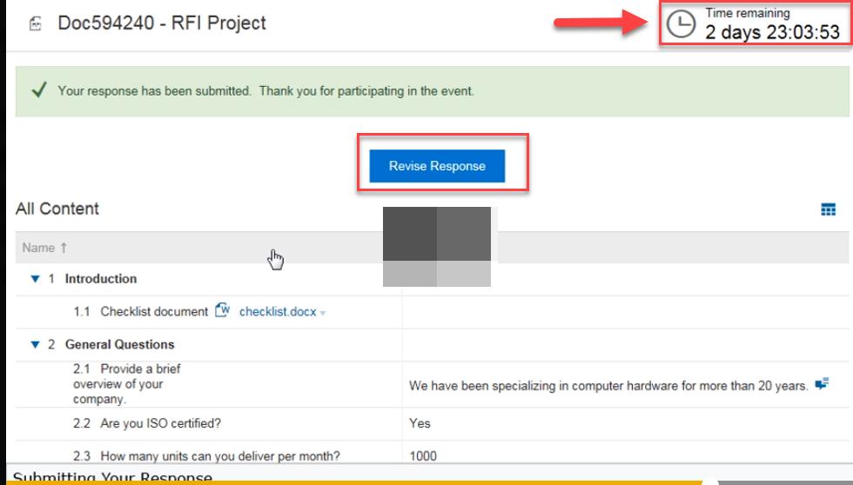
II. Step by step (RFI)
How to Revise Response
If there is a need to revise your response, click Revise Response button.
Note : You can revise your response as long as there is a time remaining which can be seen on the upper right of the screen.

Slide 18
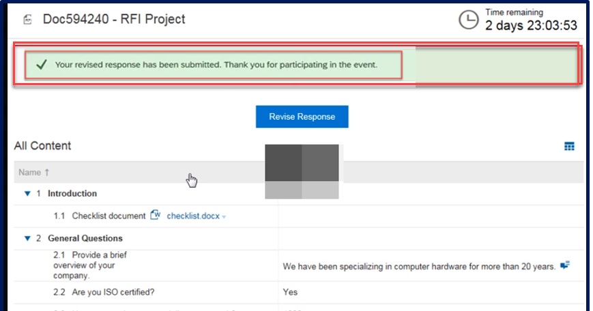
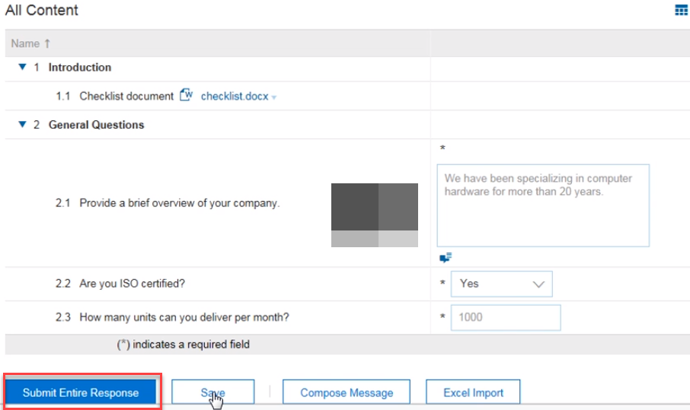
II. Step by step (RFI)
How to Revise Response
Revise Response window displays. Click OK.
All content displays. Update the answers of the item you wish to revise. And click Submit Entire Response.
A green ribbon displays which states Your response has been submitted. Thank you for participating in the event.
2
4
3

Slide 19
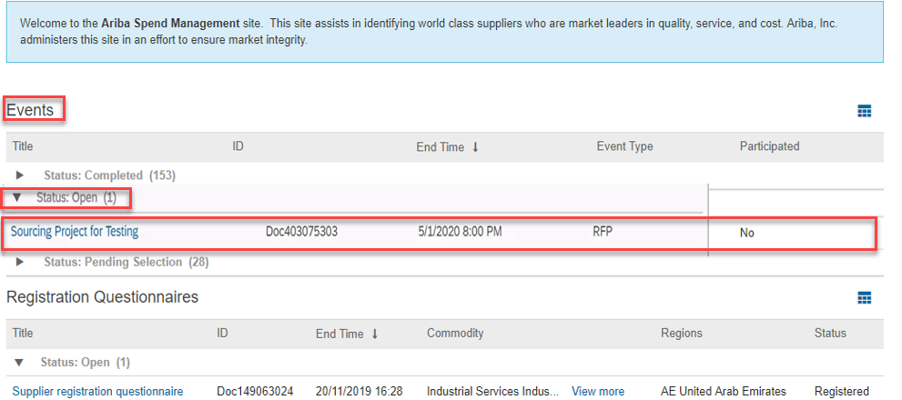
II. Step by step (RFP/Sourcing)
How to Access RFP
Sourcing Events can be seen under Events Section
Click Status: Open to expand the event and this will provide what are events which are still open that you need to submit your response with. And click the Event name.
Events section had the following sub-sections:
Completed - RFP’s/ RFI/Auctions which have been awarded to you/ some other supplier
Open - RFP’s / RFI/Auctions for which you have to submit bid.
Pending Selection: RFP’s / RFI/Auctions which are no longer accepting bids.
Preview : RFP / RFI/Auctions which have been published by the buyer, but are yet to start
1
2

Slide 20
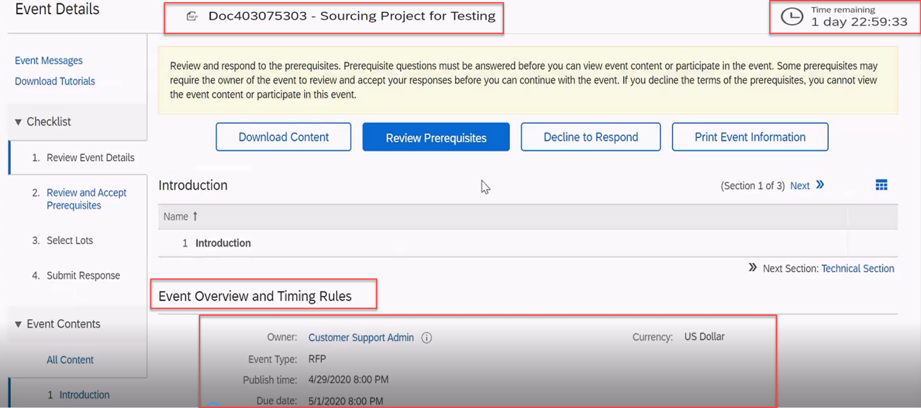
II. Step by step (RFP/Sourcing)
Review Event Details
After clicking the event you would like to participate, Event details will display.
Time Remaining – Time remaining before the event close.
Event Overview and Timing Rules – This shows Owner, Event Type, Publish Time, Due Date, and Currency
1
2
You are here
3

Slide 21
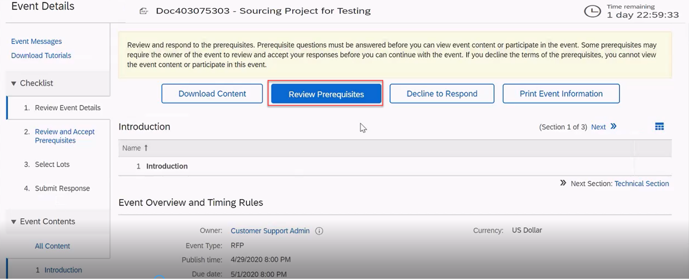
II. Step by step (RFP/Sourcing)
Review Prerequisite
Click Review Prerequisites button

Slide 22
II. Step by step (RFP/Sourcing)
Review Prerequisite
Review the terms of this agreement and click the radio button beside I accept the terms of this agreement. By accepting the agreement you can now participate in the sourcing event.
Click OK button.
Submit this agreement window displays. Click OK to Submit.
4
2
3

Slide 23
II. Step by step (RFP/Sourcing)
Select Lots
We are now under Checklist 3. Select Lots. This will show the lots available for Bidding, select the lots you would like to bid by ticking the check box beside the item.
Click Confirm Selected Lots button.
1
2

Slide 24
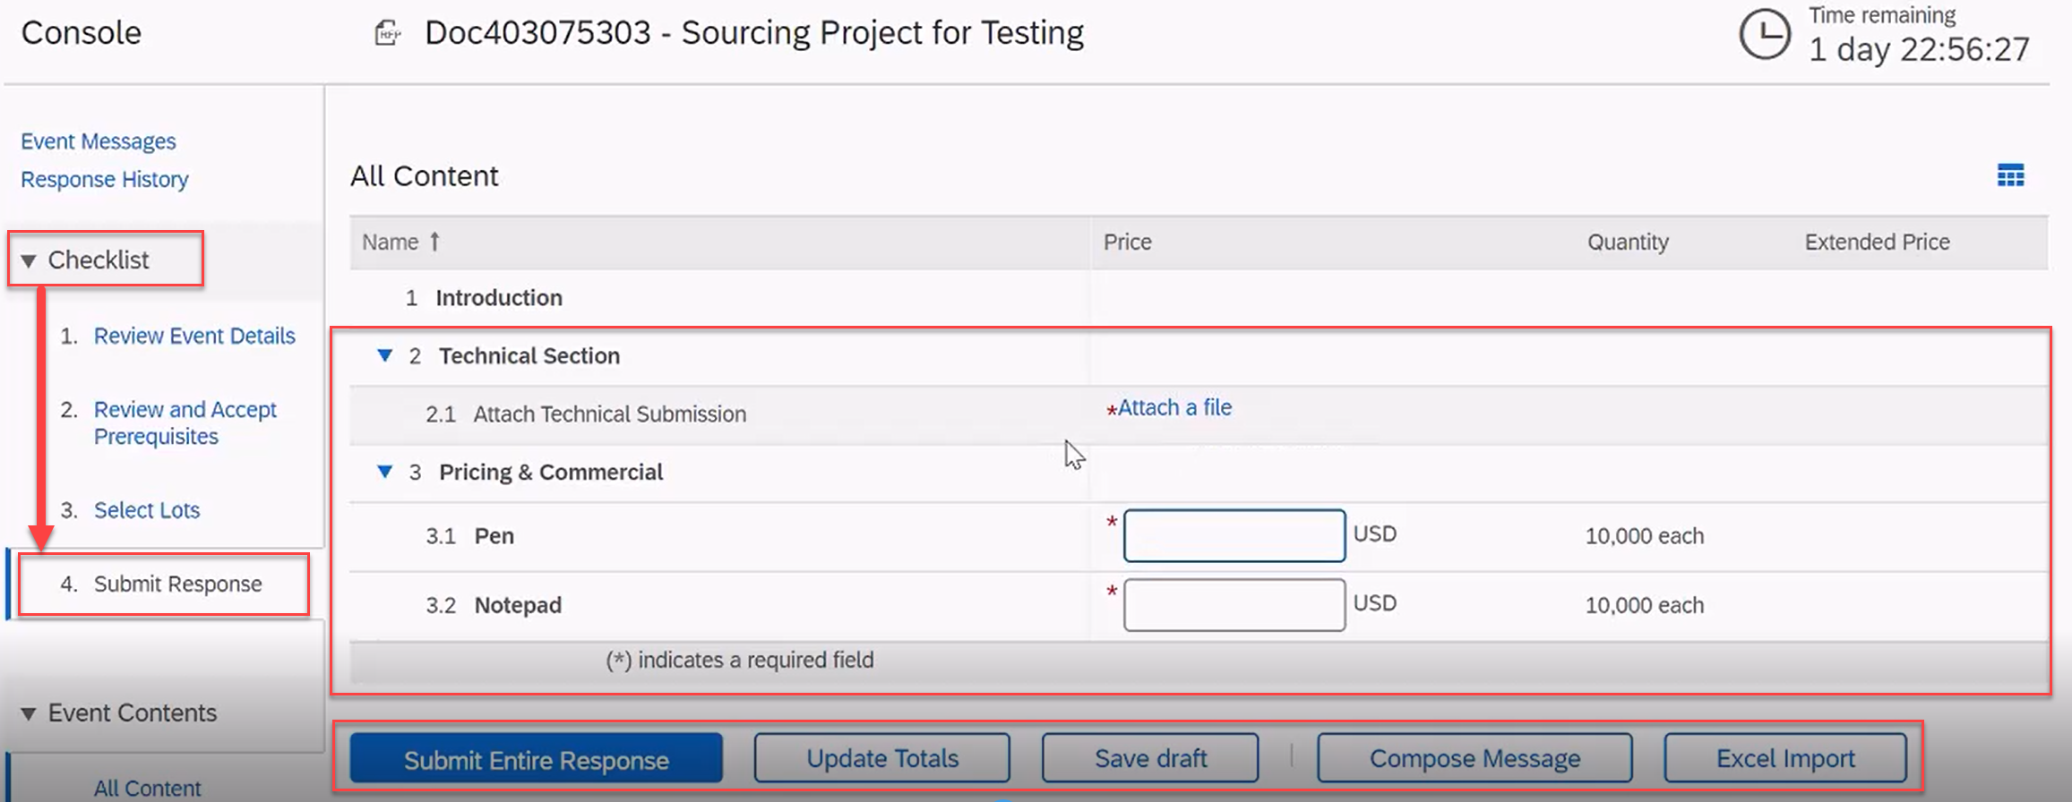
II. Step by step (RFP/Sourcing)
How to Submit Response to a Sourcing Event
We are now under Check list 4. Submit Response.
Enter your responses (prices, questions asked, attach documents) all field marked with an * are mandatory.
Submit Entire Response – this will submit the prices, attachments and any answers that you have provided.
Update Total – this will calculate the total price of the item you were bidding.
Save draft – if you wish you save your response before submitting it.
Compose Message – use this button if you have any question related to the event.
Excel Import – if you wish to import the details in excel.
2
1

Slide 25
II. Step by step (RFP/Sourcing)
How to Submit Response to a Sourcing Event
Once all mandatory section are populated, click Submit Entire Response button.
Submit this response will displays. Click OK.
3
4

Slide 26
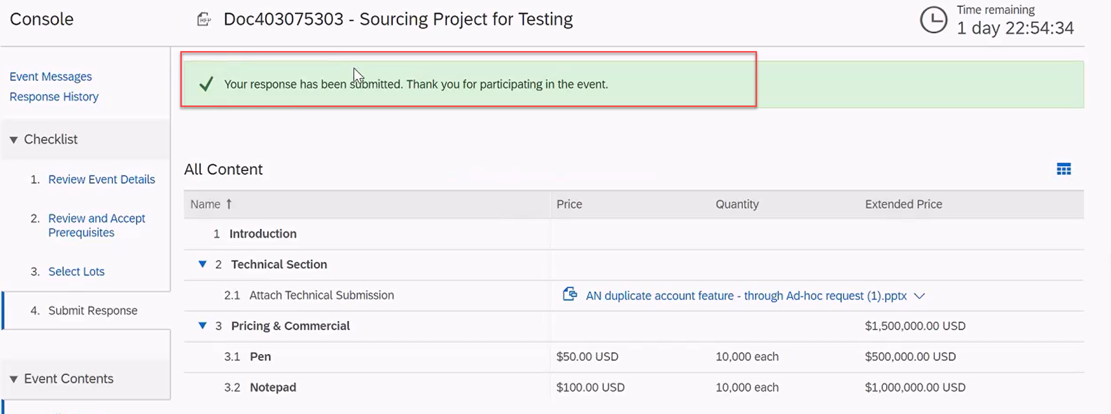
II. Step by step (RFP/Sourcing)
How to Submit Response to a Sourcing Event
A green ribbon displays which states Your response has been submitted. Thank you for participating in the event.
5

Slide 27
II. Step by step (RFP/Sourcing)
Click on Excel Import

Slide 28
II. Step by step (RFP/Sourcing)
Follow the steps :
Click on Download Content
An excel sheet would be downloaded.
Open the excel sheet > go
to pricing tab. Enter your responses
Save your file

Slide 29
II. Step by step (RFP/Sourcing)
Go to Step 3 > Choose file to upload > upload
Once the excel file is imported successfully, a dialogue box will appear > Import Successful. Click ok.
Click Submit Entire response.

Slide 30
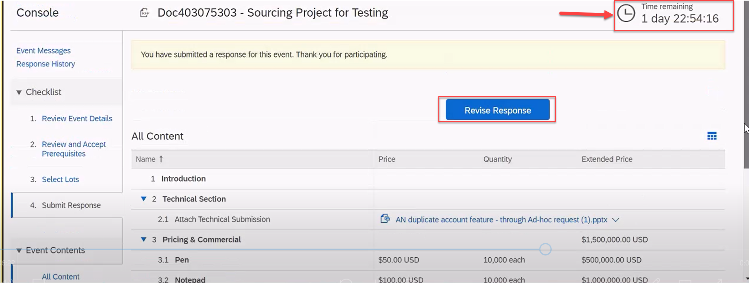
II. Step by step (RFP/Sourcing)
How to Revise Response
If there is a need to revise your response, click Revise Response button.
Note : You can revise your response as long as there is a time remaining which can be seen on the upper right of the screen.
1

Slide 31
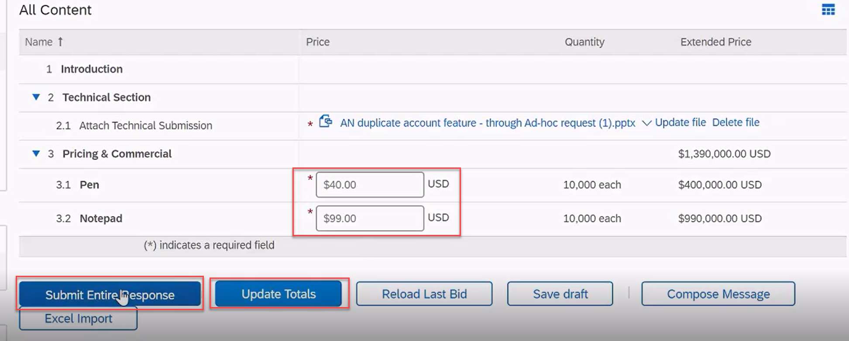
II. Step by step (RFP/Sourcing)
How to Revise Response
Revise Response window displays. Click OK.
All content displays. Update the prices of the item you wish to revise.
Click Update Totals to calculate the extended price.
Click Submit Entire Response to submit the revised price/s.
2
3
5
4

Slide 32
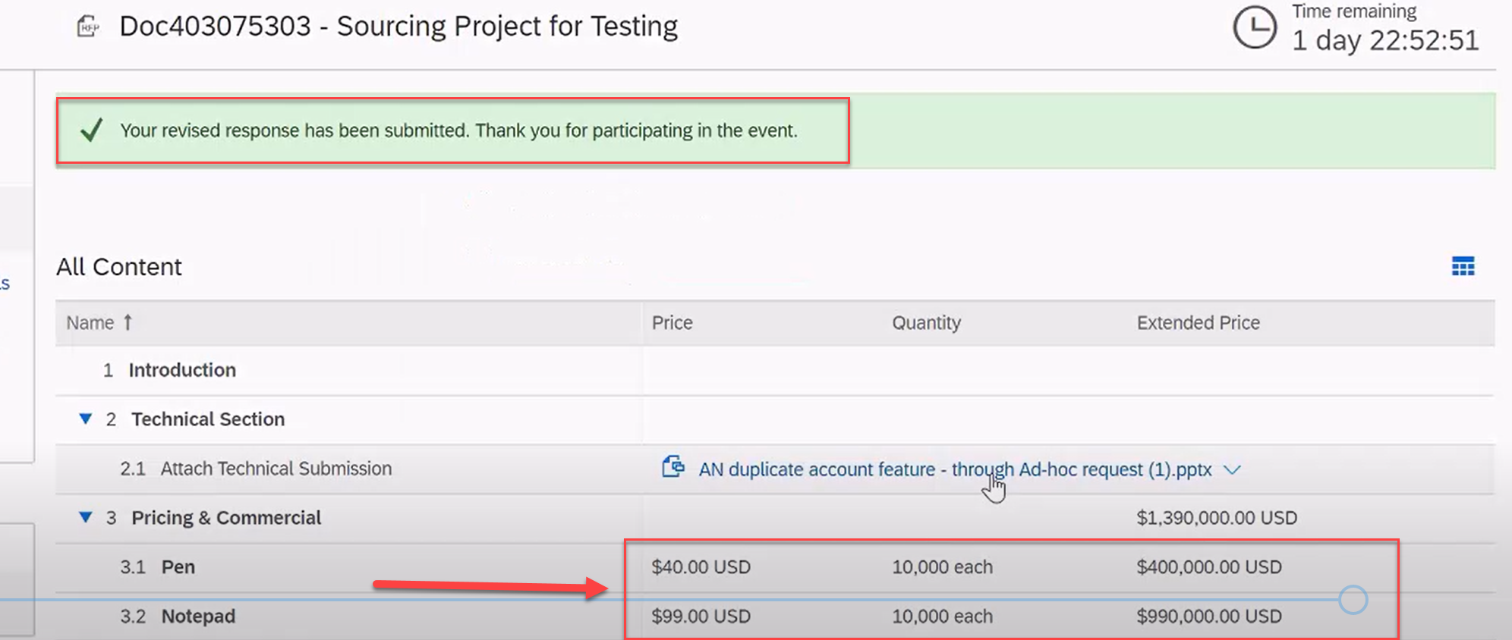
II. Step by step (RFP/Sourcing)
How to Submit Response to a Sourcing Event
A green ribbon displays which states Your response has been submitted. Thank you for participating in the event.
You may also notice that the price has been updated.
6

Slide 33
THANK YOU

