Slide 1
SAP Ariba Guidelines Qualification Process

Slide 2
CONTENT
I. Qualification Overview Process
II. Step by step

Slide 3
I. Qualification Overview Process
Supplier receive requested email to complete the qualification form
Supplier provide detail information and document then submit to NSRP
Procurement Department will review information
Supplier qualified

Slide 4
CONTENT
I. Qualification Overview Process
II. Step by step

Slide 5
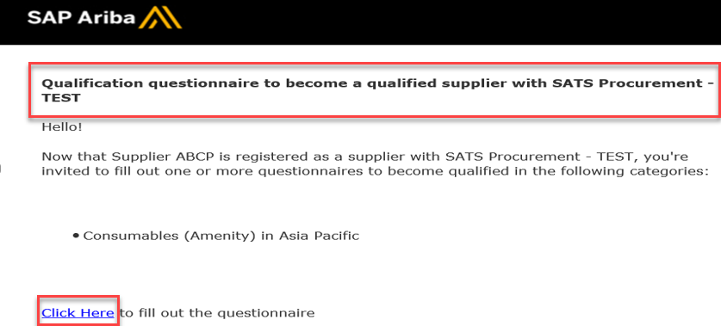
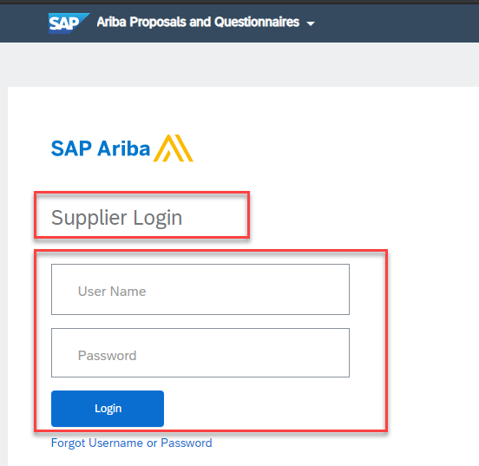
II. Step by step
Completing the qualification (if requested by NSRP)
Supplier will receive an email notification to complete the qualification questionnaire to become a qualified suppliers with NSRP.
To fill out the questionnaire please click the Click Here hyperlink.
Ariba Supplier Login page will display. Enter your Log in credentials and click Log in button.
1
3
2

Slide 6
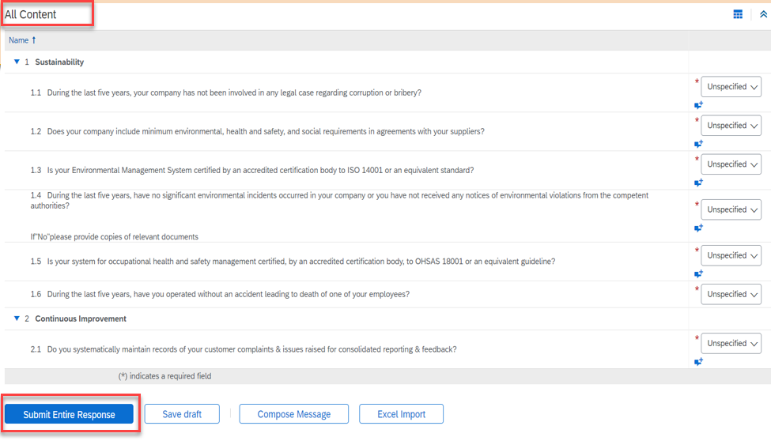
II. Step by step
Completing the qualification (if requested by NSRP)
Provide answers to the questions in the supplier qualification questionnaire.
Provide attachments whenever required
All questions marked with an * are mandatory
Once all required questions are completed, click Submit Entire Response.
4
5

Slide 7
THANK YOU

