Slide 1
SAP Ariba Guidelines Registration Process

Slide 2
CONTENT
I. Registration Overview Process
II. Register Ariba account (Self-Registration)
III. Register Ariba account (NSRP’s invitation)
IV. How to get support from SAP Ariba

Slide 3
I. Registration Overview Process
a. New supplier does not have connection with NSRP:
Supplier actively send self-registration form to NSRP
Procurement Department will review the form
If the form is approved, Supplier will receive invitation email to register for NSRP’s Ariba Network
Supplier provide detail information and document then submit to NSRP
Procurement Department will review information
Supplier register as NSRP’s supplier
b. Supplier has previous transactions with NSRP:
Supplier receive invitation email from NSRP to register for NSRP’s Ariba Network
Supplier provide detail information and document then submit to NSRP
Procurement Department will review information
Supplier register as NSRP’s supplier

Slide 4
CONTENT
I. Registration Overview Process
II. Register Ariba account (Self-Registration)
III. Register Ariba account (NSRP’s invitation)
IV. How to get support from SAP Ariba

Slide 5
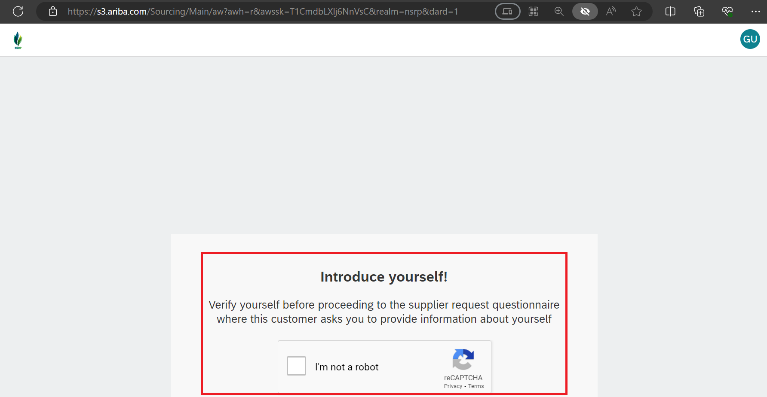
II. Register Ariba account (Self-Registration)
Supplier will need to actively send self registration form then submit to NSRP:
Click the link to access the self registration form.
Complete reCAPTCHA task.
1
Ariba Spend Management
2

Slide 6
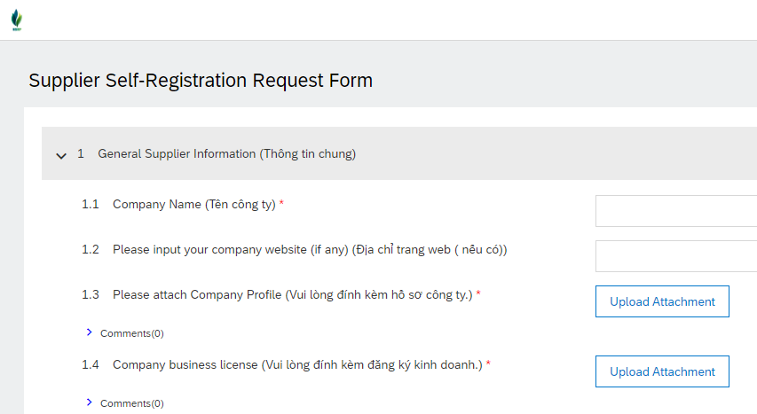
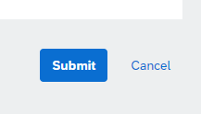
II. Register Ariba account (Self-Registration)
3. Fill all information in the form.
4. Click Submit at the bottom of the page to submit for reviewing. Please note: Once submitted, the form cannot be update.
5. If the form is accepted from NSRP. Supplier will receive invitation email to join NSRP’s Ariba Network.
3
4

Slide 7
CONTENT
I. Registration Overview Process
II. Register Ariba account (Self-Registration)
III. Register Ariba account (NSRP’s invitation)
IV. How to get support from SAP Ariba

Slide 8
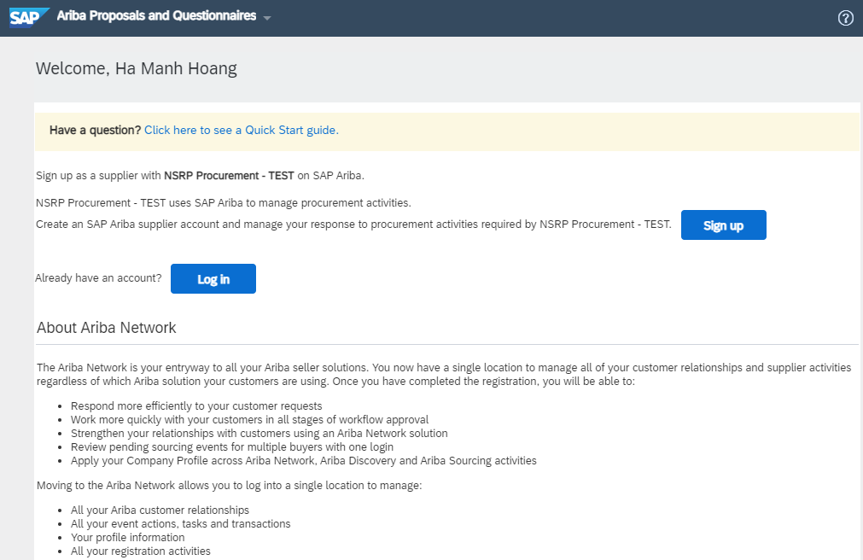
III. Register Ariba account (NSRP’s invitation)
6. Registration window will appear. There were 2 options available.
If you are new to Ariba, click Sign up button.
If you already have an existing account, click Log in and Enter your existing credentials.
a
b

Slide 9
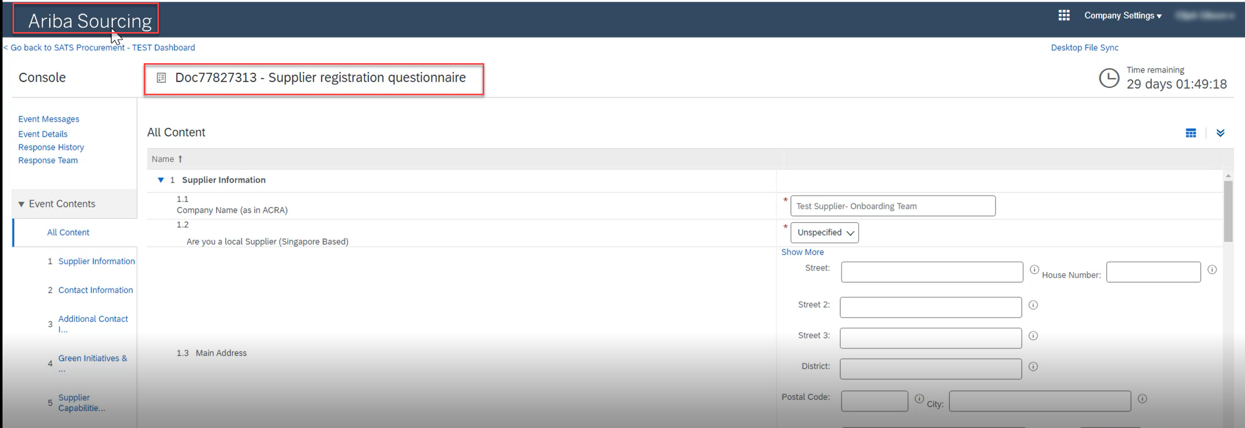
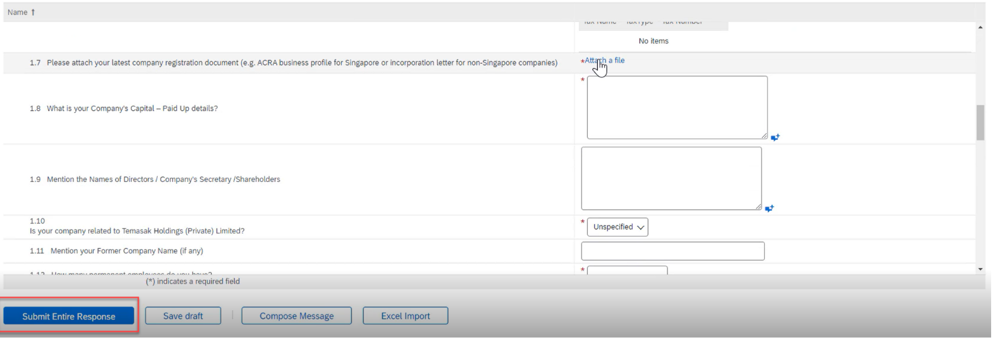
III. Register Ariba account (NSRP’s invitation)
In your account dashboard:
7. Ariba will display and show the supplier registration questionnaire
Note: All fields mark with and * are mandatory
8. Populate the fields in the registration questionnaire and provide necessary attachments if required.
9. Once all required questions has been populated, click Submit Entire Response.
7
8
9

Slide 10
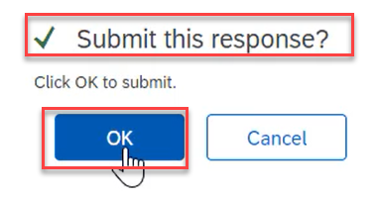
III. Register Ariba account (NSRP’s invitation)
Complete Supplier Registration Questionnaire
10. Submit this response window will prompt. Click OK to Submit your responses.
11. A green ribbon will appear on top of the page indicating that Your Response has been submitted. Thank you for participating in the event.
Once supplier is approved by NSRP team, you will receive an email notification and you will be registered with NSRP.
To update your details in future after you have been Registered, you need to Revise Responses (please use slide 23)
10
11

Slide 11
IV. How to get support from SAP Ariba
Access following link to get support from Ariba:
SAP Ariba Supplier Support | SAP Ariba
1
2

Slide 12
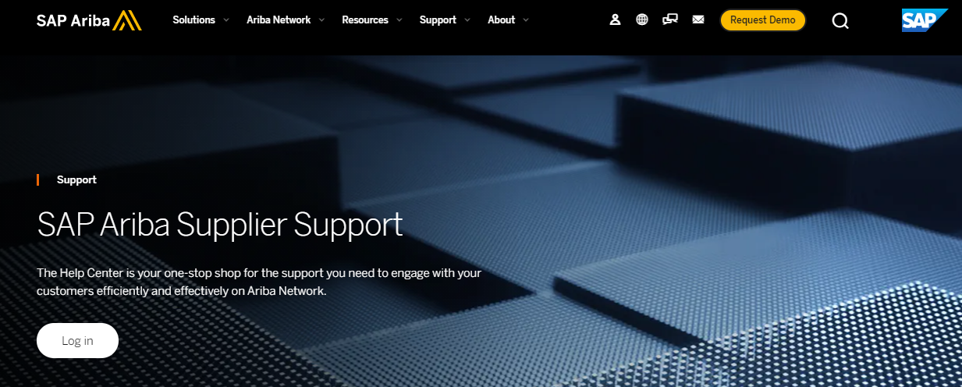
IV. How to get support from SAP Ariba
Click here to Login:
3

Slide 13
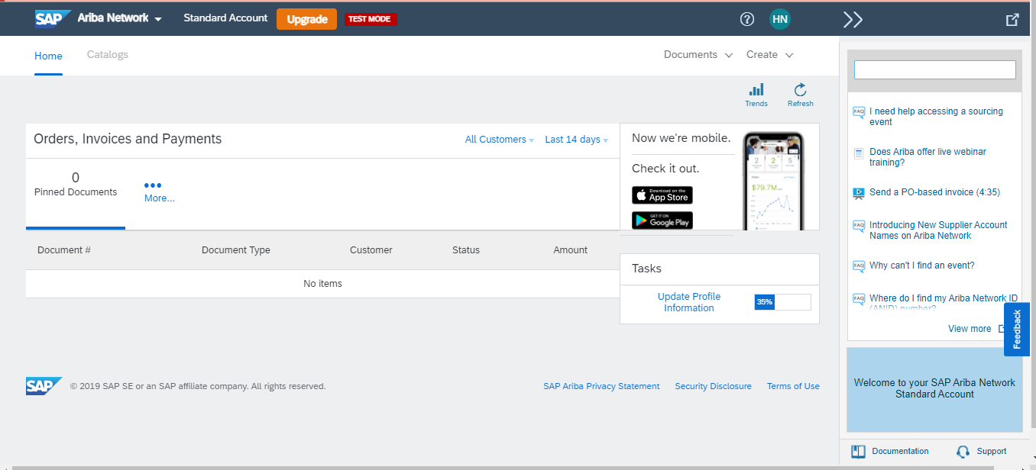
IV. How to get support from SAP Ariba
How to get support from Ariba
You can find the FAQ here.
Or you click here to go to Help Center
1
2

Slide 14
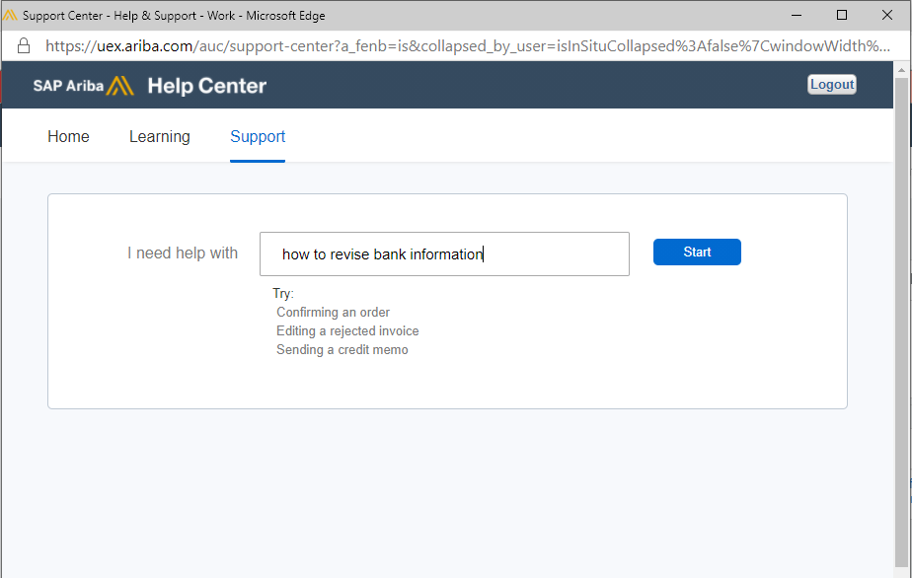
IV. How to get support from SAP Ariba
How to get support from Ariba
3. You enter the question here then click start
3

Slide 15
THANK YOU

